Slide 1




Web Applications and Services
Web Page Development
SoftUni Team
Technical Trainers
Software University
http://softuni.bg

Slide 2

Table of Contents
What are Web Pages?
How to develop web pages?
What are the technologies, used for web page development?
Different types of programming in web page development:
Client-side programming
Server-side programminga

Slide 3

Web Page Development
A web page is a web document that is suitable for the World Wide Web and the web browser
Web pages are what is displayed, but behind the scenes they are computer files, usually written in Hypertext Markup Language (HTML)
On a network, a web browser can retrieve a web page from a remote web server

Slide 4
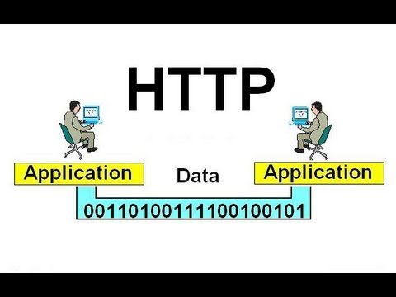
Web Page Development
In the core of the data communication between the web browsers and the web servers, stands, the Hypertext Transfer Protocol (HTTP)
HTTP is the underlying communication protocol used by the World Wide Web
HTTP uses a Uniform Resource Locator (URL) to uniquely identify and address each resource on the Internet

Slide 5

Hypertext Markup Language

Slide 6
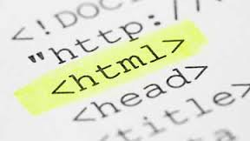
HTML
Hypertext Markup Language is the standard markup language used to create web pages
HTML provides a standard language for describing Web pages, which, different Web browsers understand and display the corresponding page

Slide 7

HTML
HTML is a text-based language
You can write and edit HTML pages using any text editor
HTML consists of a set of tags (also called as HTML elements)
The HTML elements define the structure and content of a page

Slide 8
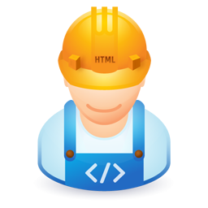
Working with HTML

Slide 9
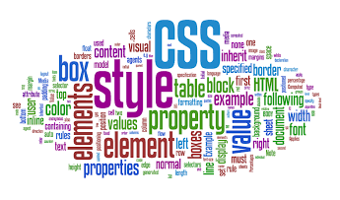
Cascading Style Sheets

Slide 10
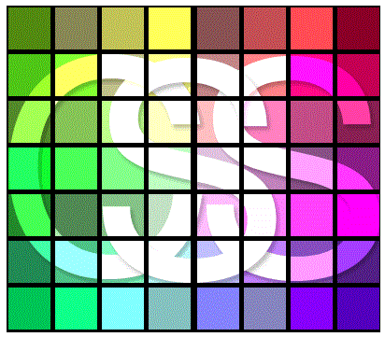
CSS
Cascading Style Sheets (CSS) is a style sheet language used for describing the presentation of a document written in a markup language
CSS is designed primarily to enable the separation of document content from document presentation
HTML specifies what will be displayed, while CSS specifies how it will be displayed

Slide 11
CSS
CSS selects the elements to which it applies styling, by element id, class, or just by tag
There are more dynamic ways of selecting elements
First child, n-th child, child element
Element parameters, etc.
CSS allows you to put all styling information in a different file
Provides better management and more readability
Is the most used strategy in practice

Slide 12
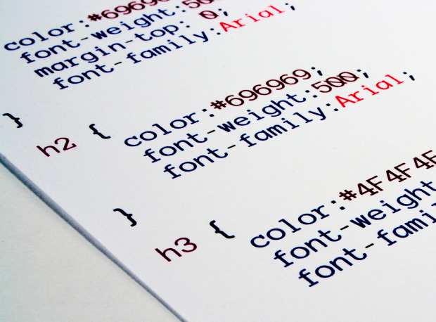
Working with CSS

Slide 13

JavaScript

Slide 14

JavaScript
JavaScript is a scripting language that runs inside Web browsers to help create far more interactive Web pages
JavaScript executes the code on the client side (the Web browser) and minimizes unnecessary round-trips to and from the Web server
Programming with JavaScript is often referred to as client-side programming

Slide 15
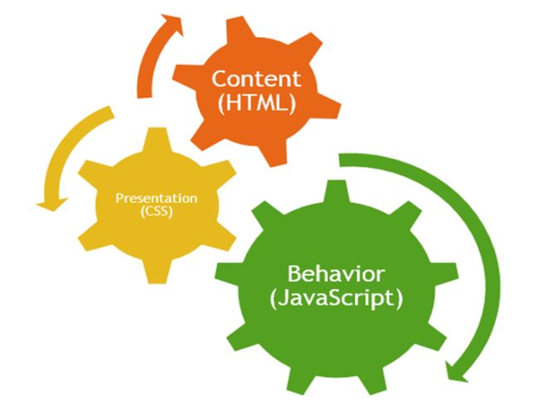
JavaScript
JavaScript, along with HTML and CSS, is one of the three core technologies of World Wide Web content production
Used by the majority of websites
Supported by all modern browsers
Being client-side, JavaScript is very fast
JavaScript is a very versatile language
JavaScript Is a multi-paradigm programming language

Slide 16
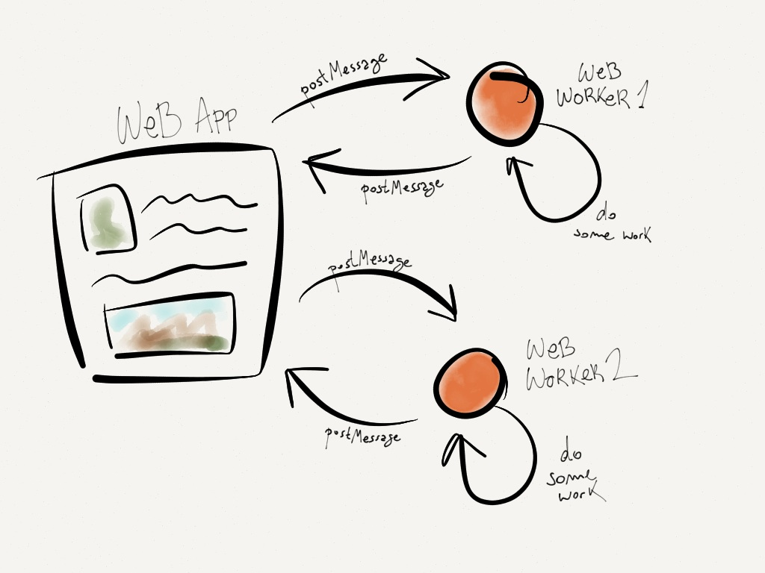
Working with JavaScript

Slide 17
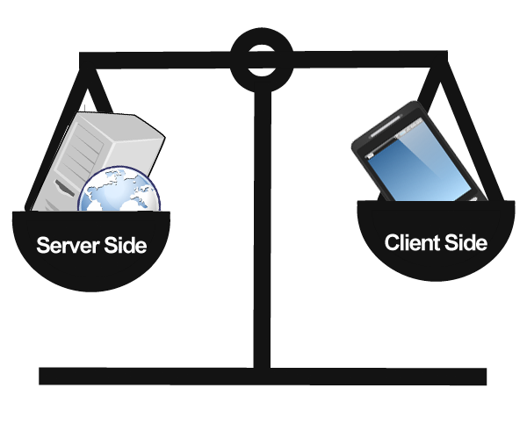
Client-side and Server-side programming

Slide 18
Client-side and Server-side programming
Whether a program is client-side or server-side depends on where the program is ultimately executed
Client-side programming
programs are executed completely on a user’s local computer
Server-side programming
Programs are executed completely on a server and make use of the server’s computational resources

Slide 19

Summary
What are Web Pages?
How are they developed?
What technologies are used for their development?
How are those technologies combined to render a web page on the web browser?
How does a web browser obtain and render a web page?
What are the different types of web page development?

Slide 20








Questions
https://softuni.bg/courses/javascript-applications/

